Slide 1
CYCLISTIC BIKE-SHARE ANALYSIS
BY
ABISHEK.S

Slide 2
Table of Contents
Business Task
Data Sources
Data Cleaning and Manipulation
Visualizations and Key Findings
Recommendations

Slide 3
Business Task
The primary business task is to analyze Cyclistic bike-share usage patterns to optimize marketing strategies and increase customer engagement and retention.

Slide 4
Data Sources
List of Data Sources:
Source 1: Bike usage logs (data analytics.csv)
Data Acquisition:
Data was collected through Google Drive and customer bike data analysis over the year.

Slide 5
Data Cleaning and Manipulation
Cleaning Processes:
Handling Missing Values:
Missing values were identified and removed from the dataset.
Removed the negative values of time difference which we calculated in the new column
Data Manipulation:
Creating New Variables:
New variables were created, including time difference for each customer.
variables for the week and days of the week were created

Slide 6
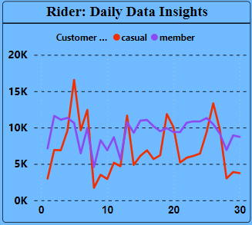
Visualizations and Key Findings
Visualization 1: Rider: Daily Data Insights
The analysis of casual and member rides per month

Slide 7
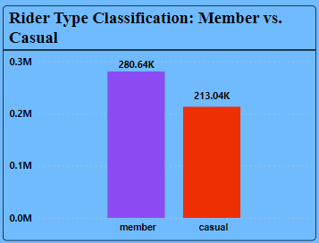
Visualizations and Key Findings
Visualization 2: Rider Type Classification: Member vs. Casual
Total customer count varies notably between member and casual rider classifications.

Slide 8
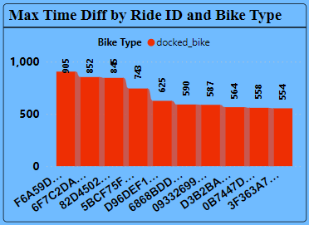
Visualizations and Key Findings
Visualization 3: Max Time Diff by Ride ID and Bike Type
The top 10 customers show significant variations in maximum time differences based on ride ID and bike type.

Slide 9
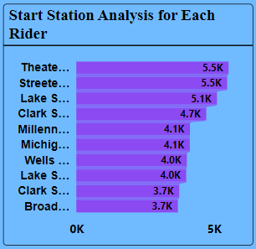
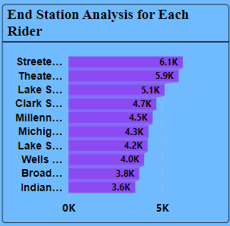
Visualizations and Key Findings
Visualization 4: Start and End Station Analysis for Each Rider
Analysis of start and end stations based on rider pick-up and drop-off locations reveals patterns in ride destinations.

Slide 10
Recommendations
Recommendation 1: Optimizing Ride Experience
Based on Analysis: Members outnumber casual customers, but casual riders have a higher average time difference.
Expected Outcome: Implement strategies to increase average time difference for members, improving their experience.
Recommendation 2: Enhancing Docked Bike Availability for Member and Casual Riders
Based on Analysis: Docked bikes are more commonly used by both members and casual customers compared to electric bikes.
Expected Outcome: Focus on enhancing the availability and accessibility of docked bikes to meet the demand of both member and casual riders.

